Slide 1
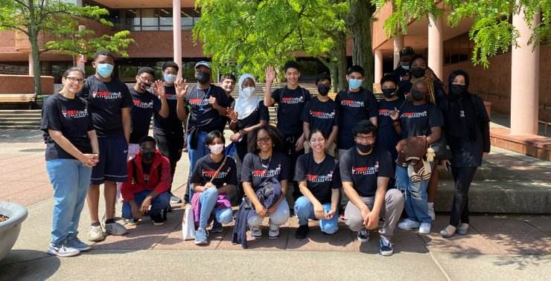

Slide 2
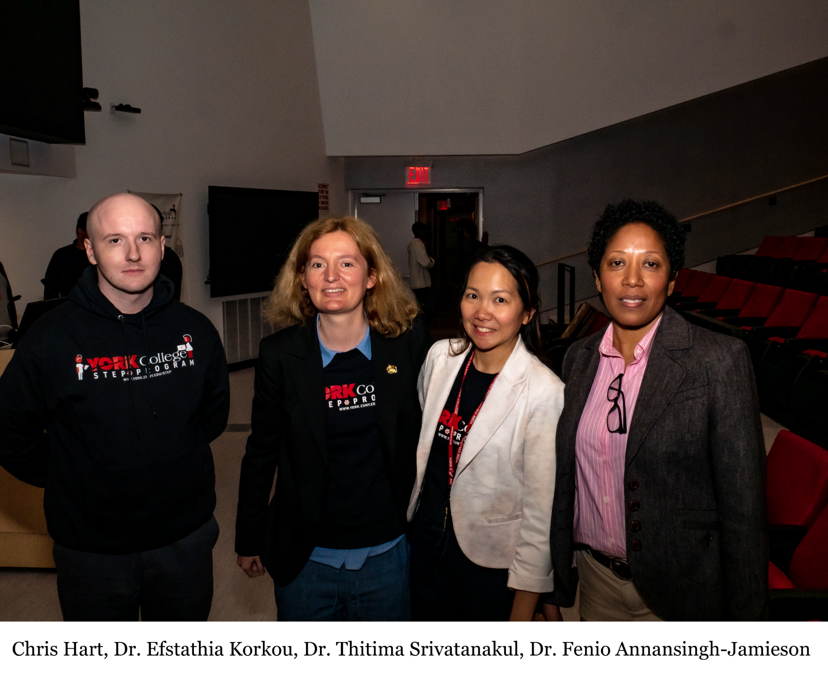

Slide 3
Mission
Increase the likelihood that historically underrepresented and economically disadvantaged students will successfully graduate high school and enter a collegiate science program. ​
Offer activities to prepare high school students for the field of math, science and technology.
Introduce high school students to research-related activities, and increase their cybersecurity, programming, math knowledge and experimental skills.

Slide 4
Who is Eligible for STEP?
Students must meet all of the following requirements to be considered for the York College Science Technology Entry Program (STEP):​
​
Be enrolled in 7-12th grade. ​
Be a New York State resident for a minimum of 12 months before applying to the program.​
Be a member of a historically underrepresented group (as defined by the New York State Education Department): African American/Black, Latino/Hispanic or Native American/Alaskan Native. (Students who are not a member of one of these groups must meet the NSYED Income Eligibility Guidelines.)

Slide 5
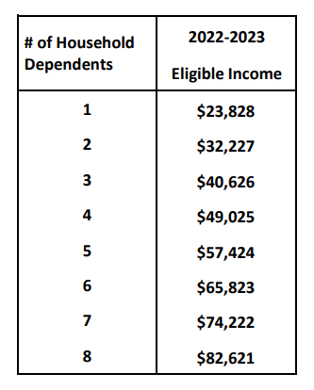
Income Eligibility

Slide 6
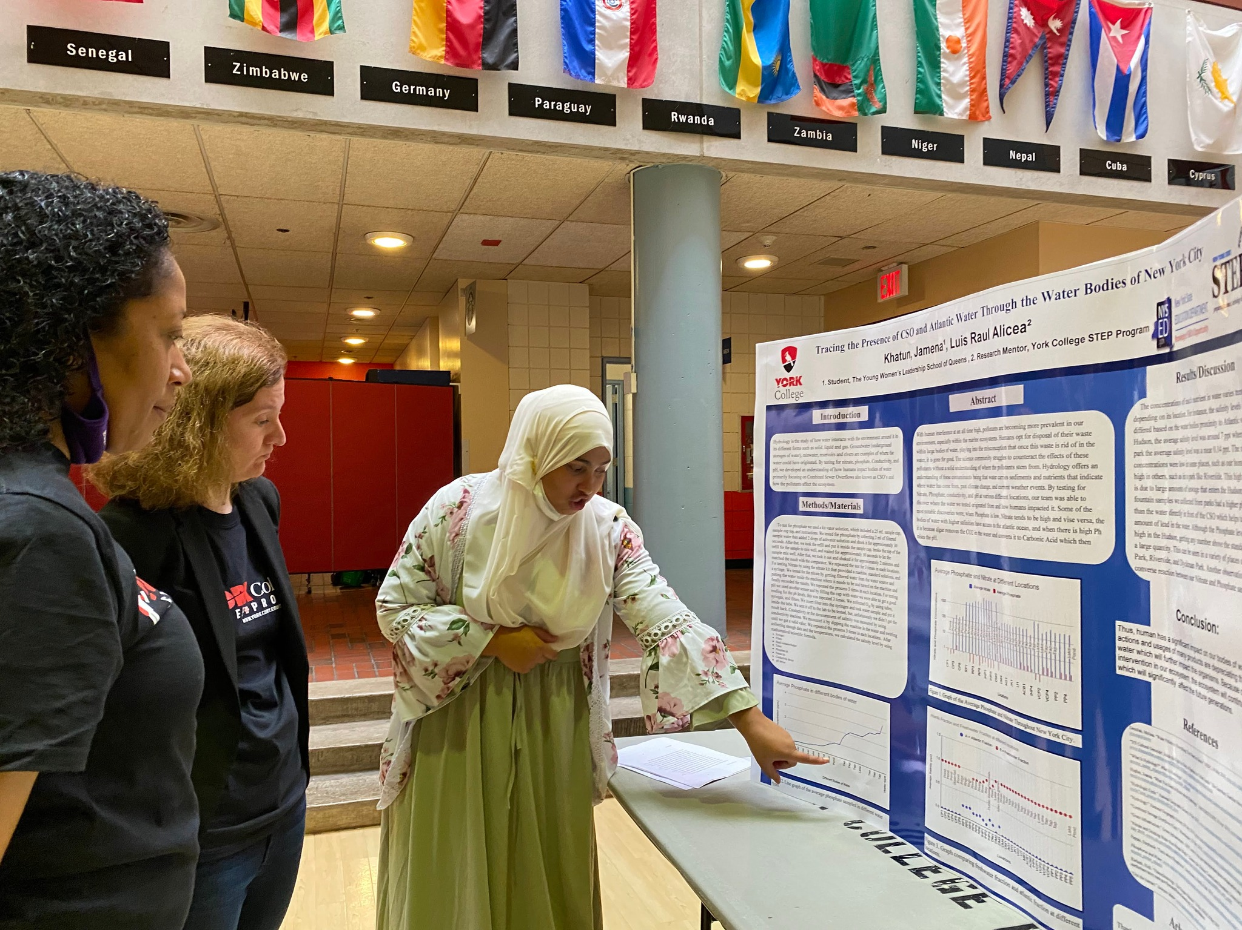
Academic Services
One-on-one tutoring
Personal growth seminars
SAT/ACT test prep
Coding courses
College credit opportunities
for high school students
(College Now)
Research programs

Slide 7
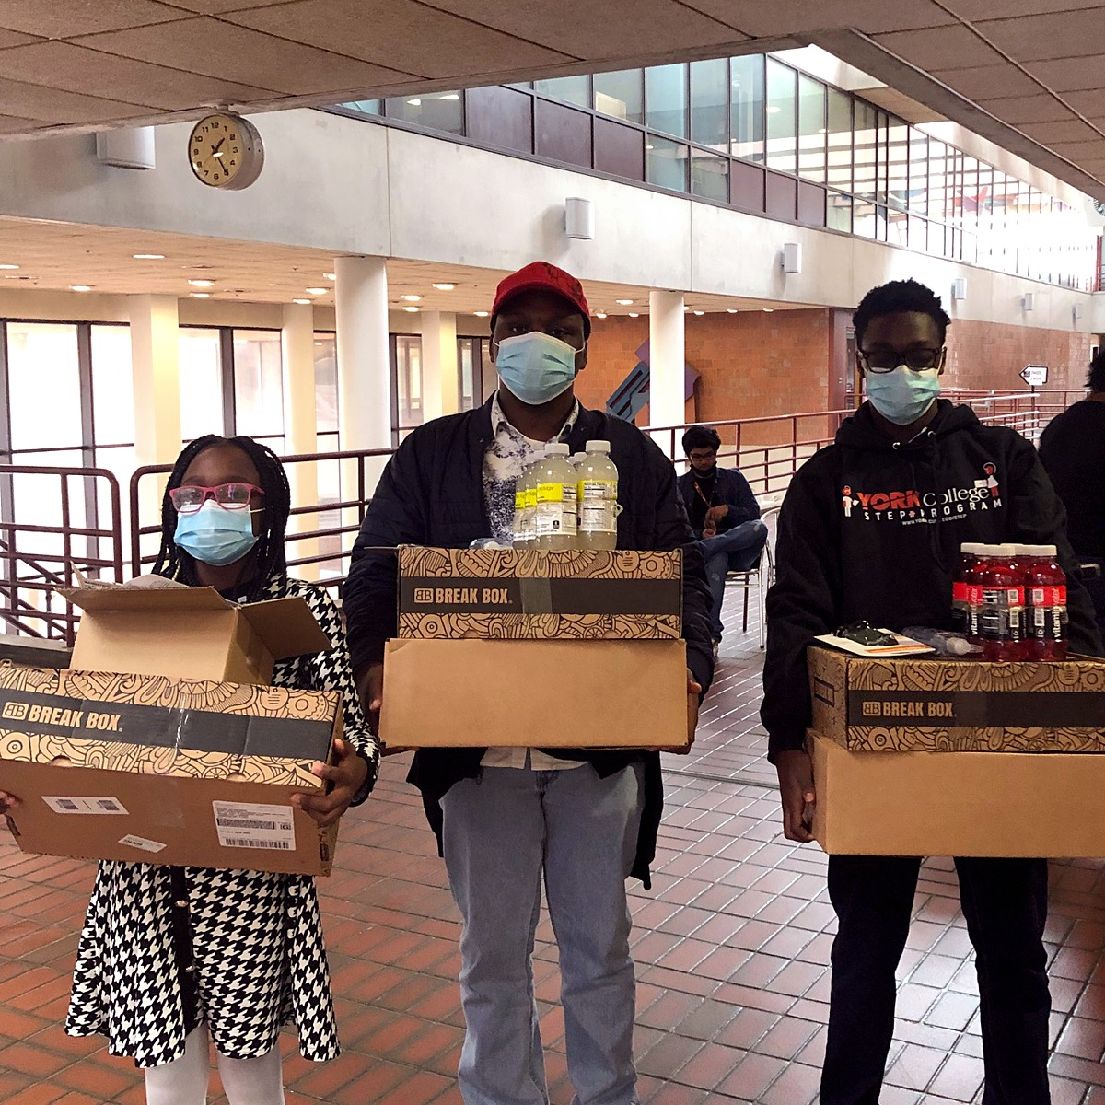
Financial Services
School supplies
Test fee reimbursement
Laptop/Chromebook loans
Scholarships
Food vouchers

Slide 8
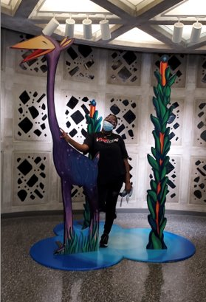
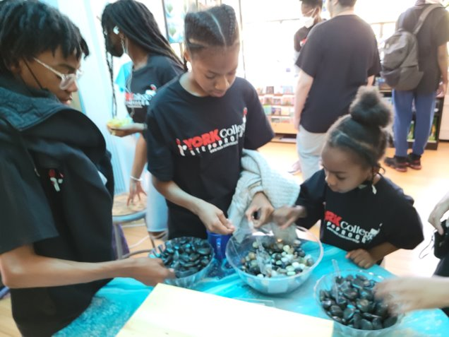
Field Trips!

Slide 9
Contact:
step@york.cuny.edu

